Slide 1
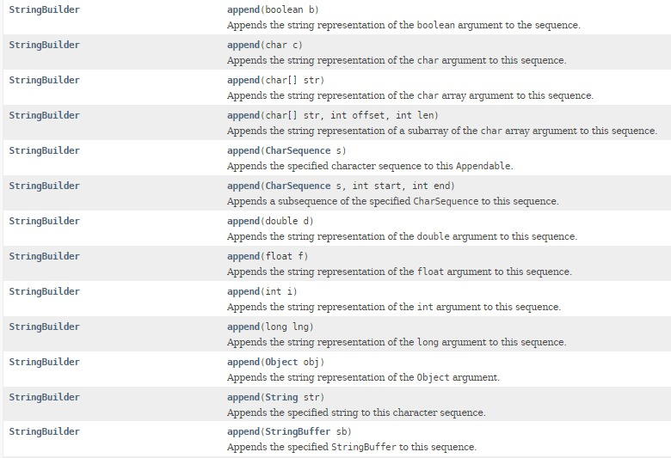
StringBuilder – append methods

